Slide 1
CS162 Operating Systems and Systems Programming Lecture 18 Disk scheduling & File Systems
October 31st, 2018
Prof. Ion Stoica
http://cs162.eecs.Berkeley.edu

Slide 2
From last lecture

Slide 3
Recal: A Little Queuing Theory: Some Results (2/2)
Why does the response/queueing delay grow unboundedly even though the utilization is < 1 ?
Queue
Server
Arrival Rate
λ
Service Rate
μ=1/T_{ser}
Parameters that describe our system:
λ: mean number of arriving customers/second λ= 1/T_{A}
T_{ser}: mean time to service a customer (“m”)
C: squared coefficient of variance = σ²/m²
μ: service rate = 1/T_{ser}
u: server utilization (0≤u≤1): u = λ/μ = λ × T_{ser}
Parameters we wish to compute:
T_{q}: Time spent in queue
L_{q}: Length of queue = λ × T_{q} (by Little’s law)
Results (M: Poisson arrival process, 1 server):
Memoryless service time distribution (C = 1): Called an M/M/1 queue
T_{q} = T_{ser} x u/(1 – u)
General service time distribution (no restrictions): Called an M/G/1 queue
T_{q} = T_{ser} x ½(1+C) x u/(1 – u))
300
Response
Time (ms)
200
100
0
0%
100%
Throughput (Utilization)
(% total BW)

Slide 4
Why unbounded response time?
Assume deterministic arrival process and service time
Possible to sustain utilization = 1 with bounded response time!
time
arrival time
service time

Slide 5
Why unbounded response time?
300
Response
Time (ms)
Assume stochastic arrival process (and service time)
No longer possible to achieve utilization = 1
200
100
This wasted time can never be reclaimed! So cannot achieve u = 1 !
0
0%
100%
Throughput (Utilization)
(% total BW)
time

Slide 6
Optimize I/O Performance
300
Response
Time (ms)
Controller
User
Thread
I/O
device
200
Queue
[OS Paths]
100
Response Time = Queue + I/O device service time
How to improve performance?
Make everything faster ☺
More decoupled (parallelism) systems
Do other useful work while waiting
Multiple independent buses or controllers
Optimize the bottleneck to increase service rate
Use the queue to optimize the service
Queues absorb bursts and smooth the flow
Add admission control (finite queues)
Limits delays, but may introduce unfairness and livelock
0
0%
100%
Throughput (Utilization)
(% total BW)

Slide 7
When is Disk Performance Highest?
When there are big sequential reads, or
When there is so much work to do that they can be piggy backed (reordering queues—one moment)
OK to be inefficient when things are mostly idle
Bursts are both a threat and an opportunity
<your idea for optimization goes here>
Waste space for speed?
Other techniques:
Reduce overhead through user level drivers
Reduce the impact of I/O delays by doing other useful work in the meantime

Slide 8
Disk Scheduling (1/2)
Disk can do only one request at a time; What order do you choose to do queued requests?
FIFO Order
Fair among requesters, but order of arrival may be to random spots on the disk ⇒ Very long seeks
SSTF: Shortest seek time first
Pick the request that’s closest on the disk
Although called SSTF, today must include rotational delay in calculation, since rotation can be as long as seek
Con: SSTF good at reducing seeks, but may lead to starvation
User
Requests
2,2
5,2
7,2
3,10
2,1
2,3
Head
3
Disk Head
2
1
4

Slide 9
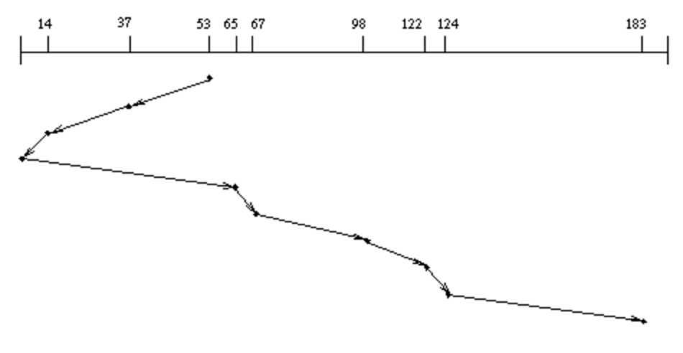
Disk Scheduling (2/2)
Disk can do only one request at a time; What order do you choose to do queued requests?
SCAN: Implements an Elevator Algorithm: take the closest request in the direction of travel
No starvation, but retains flavor of SSTF
User
Requests
2,2
5,2
7,2
3,10
2,1
2,3
Head

Slide 10
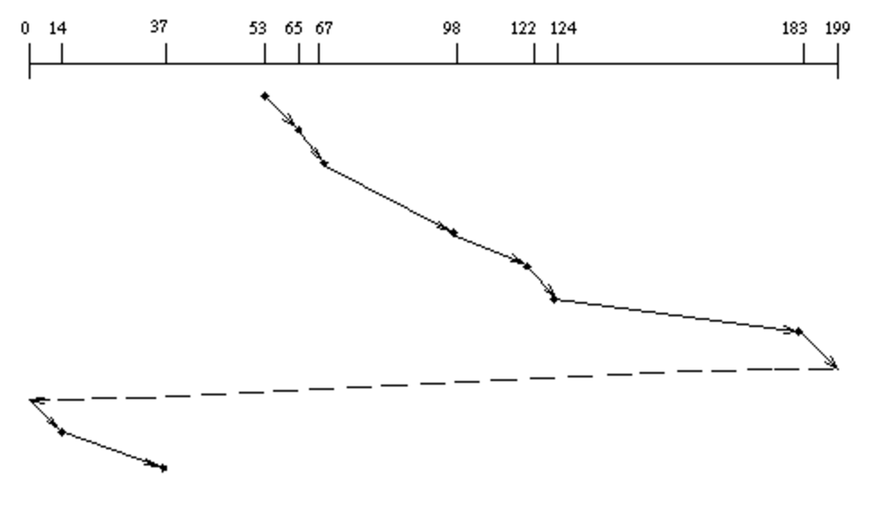
Disk Scheduling (2/2)
Disk can do only one request at a time; What order do you choose to do queued requests?
C-SCAN: Circular-Scan: only goes in one direction
Skips any requests on the way back
Fairer than SCAN, not biased towards pages in middle
User
Requests
2,2
5,2
7,2
3,10
2,1
2,3
Head

Slide 11
Recall: How do we Hide I/O Latency?
Blocking Interface: “Wait”
When request data (e.g., read() system call), put process to sleep until data is ready
When write data (e.g., write() system call), put process to sleep until device is ready for data
Non-blocking Interface: “Don’t Wait”
Returns quickly from read or write request with count of bytes successfully transferred to kernel
Read may return nothing, write may write nothing
Asynchronous Interface: “Tell Me Later”
When requesting data, take pointer to user’s buffer, return immediately; later kernel fills buffer and notifies user
When sending data, take pointer to user’s buffer, return immediately; later kernel takes data and notifies user

Slide 12
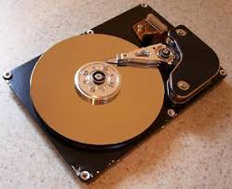
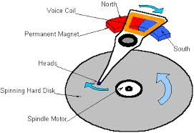
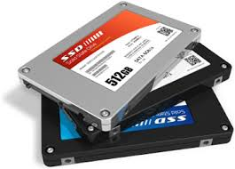

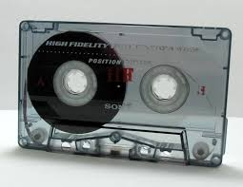
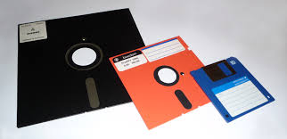
I/O & Storage Layers
Operations, Entities and Interface
Application / Service
streams
High Level I/O
Low Level I/O
handles
Syscall
registers
file_open, file_read, … on struct file * & void *
File System
descriptors
we are here …
I/O Driver
Commands and Data Transfers
Disks, Flash, Controllers, DMA

Slide 13
Recall: C Low level I/O
Operations on File Descriptors – as OS object representing the state of a file
User has a “handle” on the descriptor
#include <fcntl.h>
#include <unistd.h>
#include <sys/types.h>
int open (const char *filename, int flags [, mode_t mode])
int create (const char *filename, mode_t mode)
int close (int filedes)
Bit vector of:
Access modes (Rd, Wr, …)
Open Flags (Create, …)
Operating modes (Appends, …)
Bit vector of Permission Bits:
User|Group|Other X R|W|X
http://www.gnu.org/software/libc/manual/html_node/Opening-and-Closing-Files.html

Slide 14
Recall: C Low Level Operations
ssize_t read (int filedes, void *buffer, size_t maxsize)
- returns bytes read, 0 => EOF, -1 => error
ssize_t write (int filedes, const void *buffer, size_t size)
- returns bytes written
off_t lseek (int filedes, off_t offset, int whence)
- set the file offset
* if whence == SEEK_SET: set file offset to “offset”
* if whence == SEEK_CRT: set file offset to crt location + “offset”
* if whence == SEEK_END: set file offset to file size + “offset”
int fsync (int fildes)
– wait for i/o of filedes to finish and commit to disk
void sync (void) – wait for ALL to finish and commit to disk
When write returns, data is on its way to disk and can be read, but it may not actually be permanent!

Slide 15
Building a File System
File System: Layer of OS that transforms block interface of disks (or other block devices) into Files, Directories, etc.
File System Components
Naming: Interface to find files by name, not by blocks
Disk Management: collecting disk blocks into files
Protection: Layers to keep data secure
Reliability/Durability: Keeping of files durable despite crashes, media failures, attacks, etc.

Slide 16
Recall: User vs. System View of a File
User’s view:
Durable Data Structures
System’s view (system call interface):
Collection of Bytes (UNIX)
Doesn’t matter to system what kind of data structures you want to store on disk!
System’s view (inside OS):
Collection of blocks (a block is a logical transfer unit, while a sector is the physical transfer unit)
Block size ≥ sector size; in UNIX, block size is 4KB

Slide 17
Recall: Translating from User to System View
File
System
What happens if user says: give me bytes 2—12?
Fetch block corresponding to those bytes
Return just the correct portion of the block
What about: write bytes 2—12?
Fetch block
Modify portion
Write out Block
Everything inside File System is in whole size blocks
For example, getc(), putc() ⇒ buffers something like 4096 bytes, even if interface is one byte at a time
From now on, file is a collection of blocks

Slide 18
Disk Management Policies (1/2)
Basic entities on a disk:
File: user-visible group of blocks arranged sequentially in logical space
Directory: user-visible index mapping names to files
Access disk as linear array of sectors. Two Options:
Identify sectors as vectors [cylinder, surface, sector], sort in cylinder-major order, not used anymore
Logical Block Addressing (LBA): Every sector has integer address from zero up to max number of sectors
Controller translates from address ⇒ physical position
First case: OS/BIOS must deal with bad sectors
Second case: hardware shields OS from structure of disk

Slide 19
Recall: Disk Management Policies (2/2)
Need way to track free disk blocks
Link free blocks together ⇒ too slow today
Use bitmap to represent free space on disk
Need way to structure files: File Header
Track which blocks belong at which offsets within the logical file structure
Optimize placement of files’ disk blocks to match access and usage patterns

Slide 20
Designing a File System …
What factors are critical to the design choices?
Durable data store => it’s all on disk
(Hard) Disks Performance !!!
Maximize sequential access, minimize seeks
Open before Read/Write
Can perform protection checks and look up where the actual file resource are, in advance
Size is determined as they are used !!!
Can write (or read zeros) to expand the file
Start small and grow, need to make room
Organized into directories
What data structure (on disk) for that?
Need to allocate / free blocks
Such that access remains efficient

Slide 21
Components of a File System
File path
Directory
Structure
File Index
Structure
One Block = multiple sectors
Ex: 512 sector, 4K block
File number
“inumber”
Data blocks
“inode”
…

Slide 22
Components of a file system
file name
offset
file number
offset
Storage block
directory
index structure
Open performs Name Resolution
Translates pathname into a “file number”
Used as an “index” to locate the blocks
Creates a file descriptor in PCB within kernel
Returns a “handle” (another integer) to user process
Read, Write, Seek, and Sync operate on handle
Mapped to file descriptor and to blocks

Slide 23
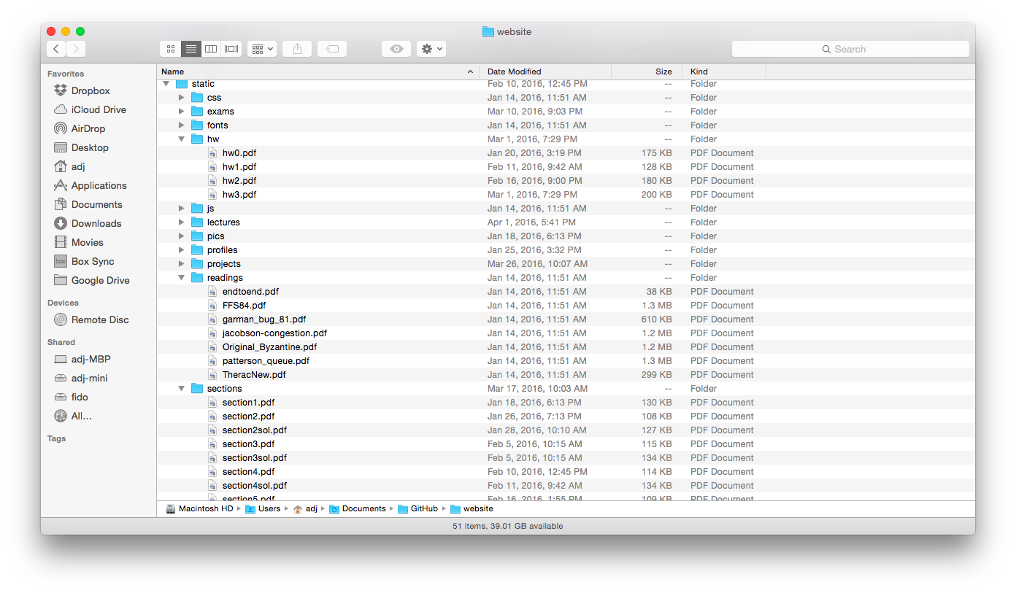
Directories

Slide 24
Directory
Basically a hierarchical structure
Each directory entry is a collection of
Files
Directories
A link to another entries
Each has a name and attributes
Files have data
Links (hard links) make it a DAG, not just a tree
Softlinks (aliases) are another name for an entry

Slide 25
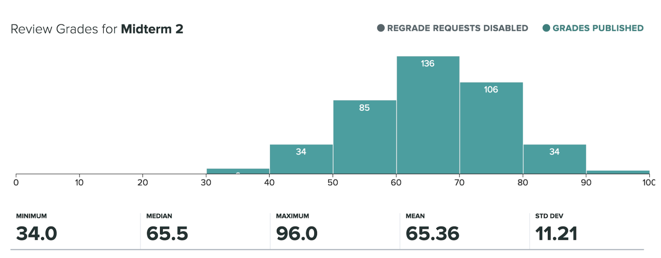
Administrivia
5 additional points to recognize the difficulty of the exam
Regrade requests deadline is next Monday Nov 5 at 11:59PM

Slide 26
break

Slide 27
I/O & Storage Layers
Application / Service
streams
High Level I/O
Low Level I/O
handles
#4 - handle
Syscall
registers
File System
descriptors
I/O Driver
Commands and Data Transfers
Data blocks
Disks, Flash, Controllers, DMA
…
Directory Structure

Slide 28
File
Named permanent storage
Contains
Data
Blocks on disk somewhere
Metadata (Attributes)
Owner, size, last opened, …
Access rights
R, W, X
Owner, Group, Other (in Unix systems)
Access control list in Windows system
Data blocks
File handle
…
File descriptor
Fileobject (inode)
Position

Slide 29
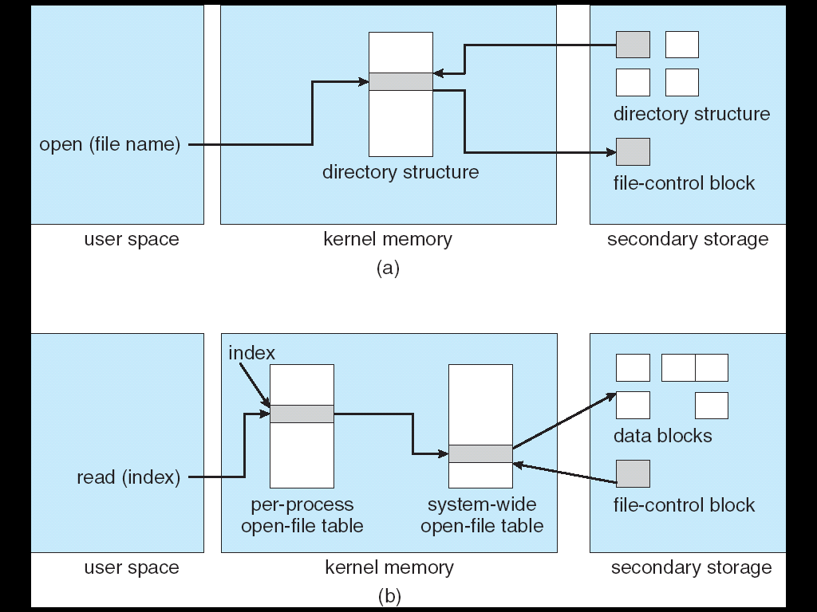
In-Memory File System Structures
Open system call:
Resolves file name, finds file control block (inode)
Makes entries in per-process and system-wide tables
Returns index (called “file handle”) in open-file table

Slide 30
In-Memory File System Structures
Read/write system calls:
Use file handle to locate inode
Perform appropriate reads or writes

Slide 31
Our first filesystem: FAT (File Allocation Table)
The most commonly used filesystem in the world!
Assume (for now) we have a way to translate a path to a “file number”
i.e., a directory structure
Disk Storage is a collection of Blocks
Just hold file data (offset o = < B, x >)
Example: file_read 31, < 2, x >
Index into FAT with file number
Follow linked list to block
Read the block from disk into memory
FAT
Disk Blocks
file number
0:
0:
31:
File 31, Block 0
File 31, Block 1
File 31, Block 2
N-1:
N-1:
memory

Slide 32
FAT Properties
File is collection of disk blocks
FAT is linked list 1-1 with blocks
File Number is index of root of block list for the file
File offset (o = < B, x >)
Follow list to get block #
Unused blocks ⬄ FAT free list
FAT
Disk Blocks
file number
0:
0:
31:
File 31, Block 0
File 31, Block 1
free
File 31, Block 2
N-1:
N-1:
memory

Slide 33
FAT Properties
File is collection of disk blocks
FAT is linked list 1-1 with blocks
File Number is index of root of block list for the file
File offset (o = < B, x > )
Follow list to get block #
Unused blocks ⬄ FAT free list
Ex: file_write(31, < 3, y >)
Grab blocks from free list
Linking them into file
FAT
Disk Blocks
file number
0:
0:
31:
File 31, Block 0
File 31, Block 1
File 31, Block 3
free
File 31, Block 2
N-1:
N-1:
memory

Slide 34
FAT Properties
File is collection of disk blocks
FAT is linked list 1-1 with blocks
File Number is index of root of block list for the file
Grow file by allocating free blocks and linking them in
Ex: Create file, write, write
FAT
Disk Blocks
file number
0:
0:
31:
File 31, Block 0
File 31, Block 1
File 63, Block 1
File 31, Block 3
free
63:
File 63, Block 0
File 2 number
File 31, Block 2
N-1:
N-1:
memory

Slide 35
FAT Assessment
FAT32 (32 instead of 12 bits) used in Windows, USB drives, SD cards, …
Where is FAT stored?
On Disk, on boot cache in memory, second (backup) copy on disk
What happens when you format a disk?
Zero the blocks, link up the FAT free-list
What happens when you quick format a disk?
Link up the FAT free-list
Simple
Can implement in device firmware
FAT
Disk Blocks
file number
0:
0:
31:
File 31, Block 0
File 31, Block 1
File 63, Block 1
File 31, Block 3
free
63:
File 63, Block 0
File 2 number
File 31, Block 2
N-1:
N-1:
memory

Slide 36
FAT Assessment – Issues
Time to find block (large files) ??
Block layout for file ???
Sequential Access ???
Random Access ???
Fragmentation ???
MSDOS defrag tool
Small files ???
Big files ???
FAT
Disk Blocks
file number
0:
0:
31:
File 31, Block 0
File 31, Block 1
File 63, Block 1
File 31, Block 3
free
63:
File 63, Block 0
File 2 number
File 31, Block 2
N-1:
N-1:
memory

Slide 37
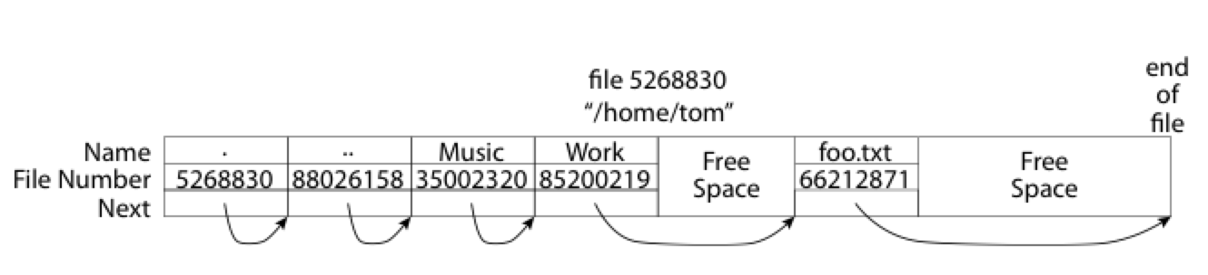
What about the Directory?
Essentially a file containing <file_name: file_number> mappings
Free space for new entries
In FAT: file attributes are kept in directory (!!!)
Each directory a linked list of entries
Where do you find root directory ( “/” )?

Slide 38
Directory Structure (cont’d)
How many disk accesses to resolve “/my/book/count”?
Read in file header for root (fixed spot on disk)
Read in first data block for root
Table of file name/index pairs. Search linearly – ok since directories typically very small
Read in file header for “my”
Read in first data block for “my”; search for “book”
Read in file header for “book”
Read in first data block for “book”; search for “count”
Read in file header for “count”
Current working directory: Per-address-space pointer to a directory (inode) used for resolving file names
Allows user to specify relative filename instead of absolute path (say CWD=“/my/book” can resolve “count”)

Slide 39
Many Huge FAT Security Holes!
FAT has no access rights
FAT has no header in the file blocks
Just gives an index into the FAT
(file number = block number)

Slide 40
Summary
File System:
Transforms blocks into Files and Directories
Optimize for access and usage patterns
Maximize sequential access, allow efficient random access
File (and directory) defined by header, called “inode”
File Allocation Table (FAT) Scheme
Linked-list approach
Very widely used: Cameras, USB drives, SD cards
Simple to implement, but poor performance and no security
Look at actual file access patterns – many small files, but large files take up all the space!

Slide 41


